Slide 1
PL-566
Small Watershed Program
Roylene Comes at Night
NRCS-WA State Conservationist

Slide 2
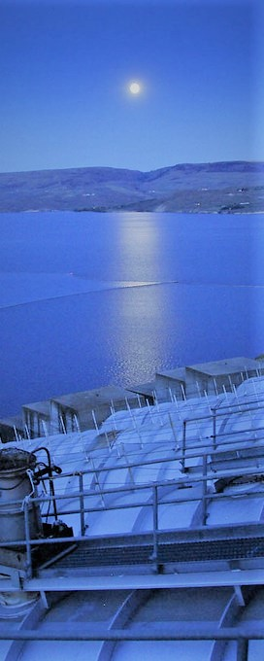
PL-566
Small Watershed Program
NRCS is Pleased to be here with you today!
There has been Significant Local Investment.
Infrastructure Investment and Jobs Act (IIJA) Funding has been provided for Watershed Plan Development.

Slide 3
PL-566
Small Watershed Program
We’re here to describe how the Small Watershed Program fits in to all the work completed so far.

Slide 4
PL-566
Small Watershed Program
Larry Johnson, P.E.
State Conservation Engineer &
Small Watershed Program Manager

Slide 5
PL-566
Small Watershed Program
Overview
NRCS cooperates with States and local agencies (Sponsor) to develop a watershed plan and to implement approved activities.
ECBID is the Project Sponsor.

Slide 6
PL-566
Small Watershed Program
Project Sponsor and NRCS Partnership
NRCS and the Project Sponsor collaborate though the entire process.
NRCS and Sponsor have defined roles and responsibilities.

Slide 7
PL-566
Small Watershed Program
Project Sponsor and NRCS Partnership
NRCS does not work with private landowners through this program.
When necessary, the Project Sponsor will.

Slide 8
PL-566
Small Watershed Program
Project Sponsor and NRCS Partnership
All NRCS $$$$$ will go to the Sponsor for:
  Watershed Plan Development (100%)
  Construction (Up to 75%)

Slide 9
PL-566
Small Watershed Program
Current Funding
$765,000 have been provided to NRCS to complete a Watershed Plan.
Construction Funds cannot be requested until the Watershed Plan has been approved.

Slide 10
PL-566
Small Watershed Program
So, where are we at today?

Slide 11
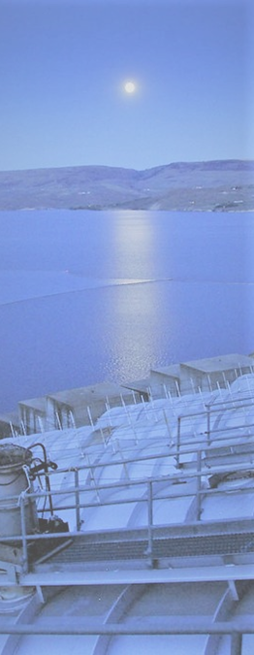
PL-566
Small Watershed Program
Steps
There are four basic steps to fully implement a watershed project.

Slide 12
PL-566 Small
Watershed Program
Steps 1 through 4
1
2
3
4
Preliminary Investigation Feasibility Report
Application for Federal Assistance
Implement Watershed
Plan - EIS
Watershed
Plan - EIS

Slide 13

PL-566 Small
Watershed Program
Steps 1 through 4
1
2
3
4
Preliminary Investigation Feasibility Report
Application for Federal Assistance
Implement Watershed
Plan - EIS
Watershed
Plan - EIS

Slide 14
PL-566 Small
Watershed Program
Steps 1 through 4
1
2
3
4
Preliminary Investigation Feasibility Report
Application for Federal Assistance
Implement Watershed
Plan - EIS
Watershed
Plan - EIS

Slide 15
PL-566 Small
Watershed Program
Steps 1 through 4
1
2
3
4
Preliminary Investigation Feasibility Report
Application for Federal Assistance
Implement Watershed
Plan - EIS
Watershed
Plan - EIS
In Progress

Slide 16
Watershed Plan-EIS
3
“Breakout”
Watershed
Plan - EIS
In Progress

Slide 17
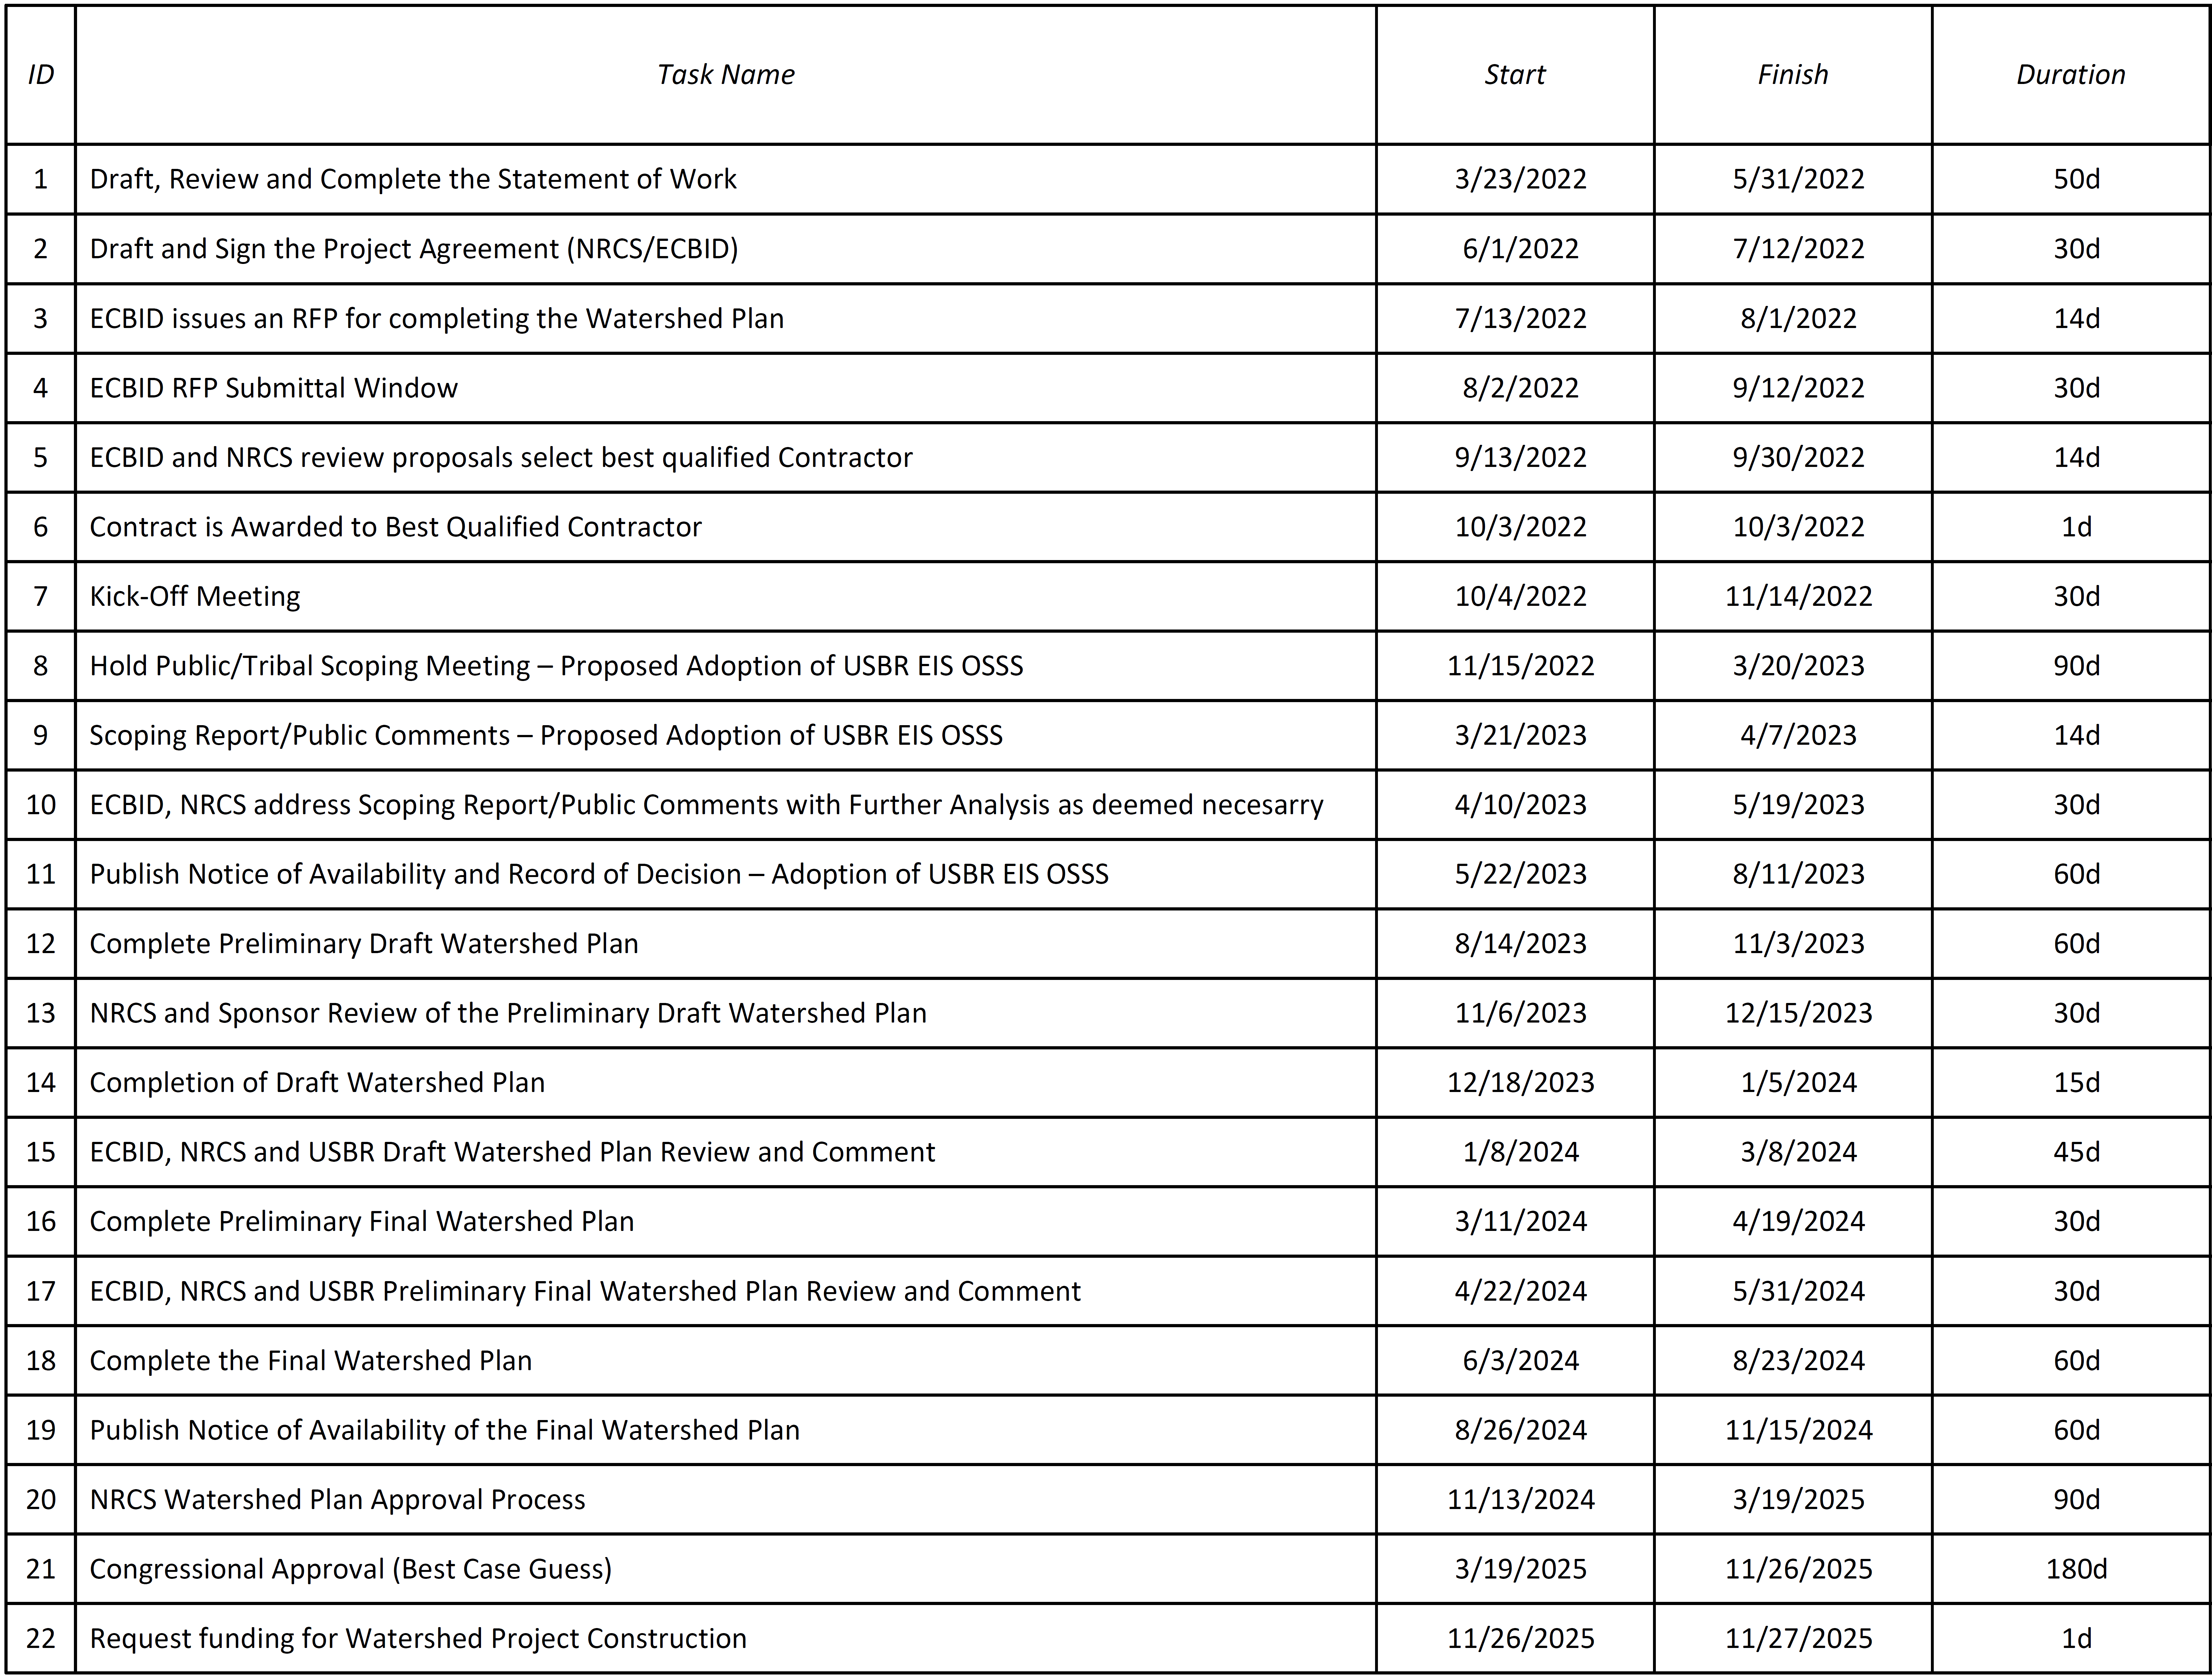
PL-566 Small Watershed Program
3
Watershed
Plan - EIS
In Progress

Slide 18
PL-566 Small Watershed Program
3
Watershed
Plan - EIS
In Progress

Slide 19
PL-566 Small Watershed Program
3
Watershed
Plan - EIS
In Progress

Slide 20
PL-566
Small Watershed Program
3
Takeaway Points….
  Host a Public Meeting.
  NRCS Adoption of the USBR EIS-OSSS.
  Complete the Watershed Plan.
  Approve the Watershed Plan.
Watershed
Plan - EIS
In Progress

Slide 21
PL-566 Small Watershed Program
Project Schedule, it is an Estimate!
3
Watershed
Plan - EIS
In Progress

Slide 22
PL-566 Small Watershed Program
Projected Completion Date:
“Best Case” “Worst Case”
3
3
vs.
Watershed
Plan - EIS
Estimated December 2025
Watershed
Plan - EIS
Estimated
April 2027

Slide 23
Plan Implementation
4
“Breakout”
Implement Watershed
Plan - EIS

Slide 24
PL-566
Small Watershed Program
4
Takeaway points…
Design/Construction Plans; NRCS or Sponsor
Land Rights/Easements/Permits; Sponsor
Construction Funding; NRCS & Sponsor
O&M Plan/Agreement; NRCS & Sponsor
Project Agreement for Construction; NRCS & Sponsor
Pump Plant and Lateral Construction; NRCS or Sponsor
Implement Watershed Plan - EIS

Slide 25
PL-566
Small Watershed Program
4
Activities already contributing to Step 4!!
Completed Design work and Construction Plans for Pump Plants and Pipeline Laterals.
Land Rights and Easements for Construction.
Implement Watershed Plan - EIS

Slide 26

Questions

