Slide 1





Odessa Ground Water
Replacement Program
OGWRP Watershed Planning Project
May 23rd, 2022

Slide 2
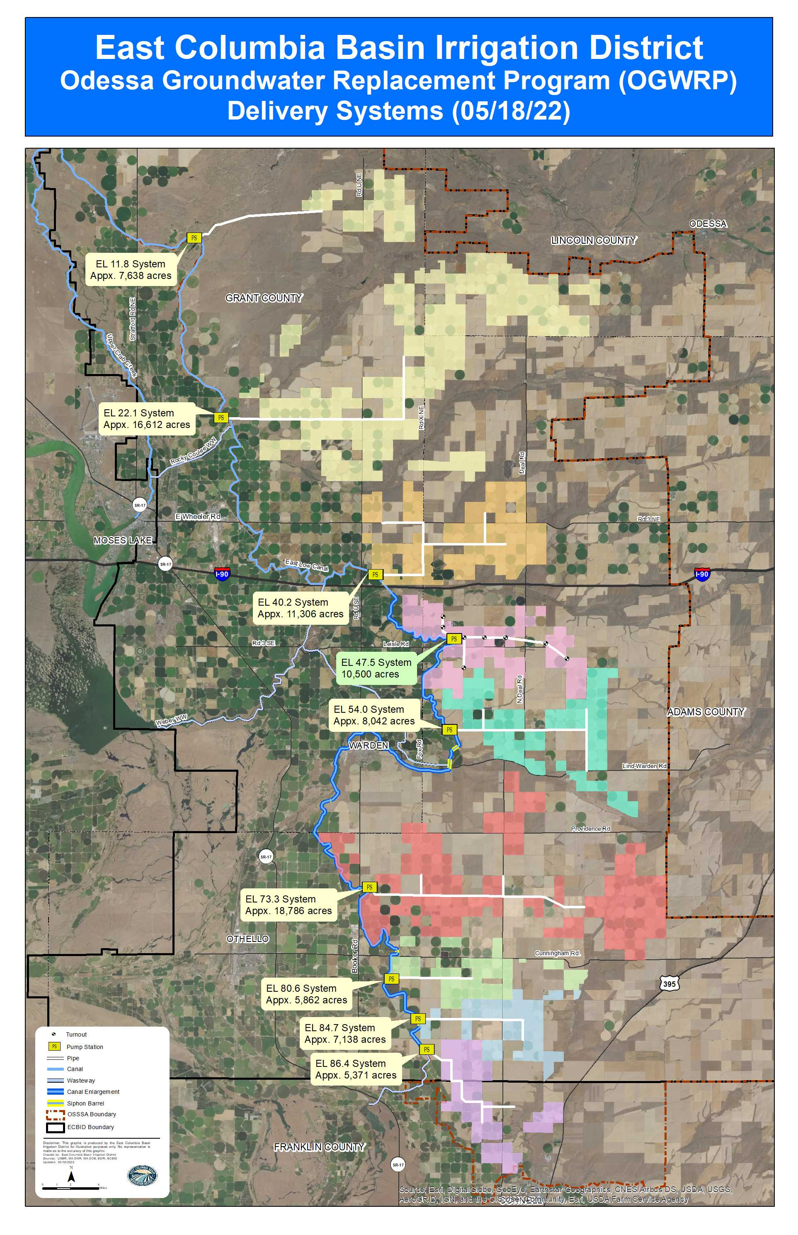

Slide 3


Roles & Responsibilities
PL-566 – OGWRP Watershed Plan

Slide 4
Sponsor for the OGWRPWPP
Co-development of Plan
Ensure consistent and coordinated communications
Co-lead for communications on all OGWRPWPP items
Sponsor for OGWRPWPP funding requests
Ensure consistency with the Odessa Subarea Special Study FEIS and ROD (2012/2013)

Slide 5
Has overall responsibility in the development of the OGWRPWPP.
Approves watershed plan.
Provides funding for development of the watershed plan.
Prepares technical requirements and oversight for the development of the watershed plan.
Ensures the SOW is adhered to.
Ensures NEPA process is adhered to in the development of the watershed plan.
Ensure consistent and coordinated communications
Co-lead for communications on all OGWRPWPP items

Slide 6
Invited by NRCS and Funded by the WA State Legislature to pursue and coordinate NRCS programs for OGWRP, including PL-566 and RCPP
Provides coordination and administrative support for ECBID and NRCS to develop the PL-566 watershed plan
Coordinating and developing communications; maintains www.ogwrp-programs.org website and newsletter
Pursuing and coordinating NRCS on-farm funding and technical assistance
Conducting on-farm assessments and planning to accelerate implementation

Slide 7
Supporter for the OGWRPWPP
Support subcontractors during plan development
Ensure consistent and coordinated communications
Co-lead for communications on all OGWRPWPP items
Support documentation for OGWRPWPP funding requests
Ensure consistency with the Odessa Subarea Special Study FEIS and ROD (2012/2013)

Slide 8
Supporter for the OGWRPWPP
Co-development of plan.
Ensure consistent and coordinated communications
Co-lead for communications on all OGWRPWPP items
Distribute questions to appropriate partners for answers
Support documentation for OGWRPWPP funding requests
Ensure consistency with the Odessa Subarea Special Study FEIS and ROD (2012/2013)

Slide 9
ECBID – Jon Erickson, Development Coordinator
jerickson@ecbid.org
509-488-9671 x135
USBR – Jennifer Hickenbottom, Odessa Project Manager
jhickenbottom@usbr.gov
509-573-8043
GCCD – Kristina Ribellia, Executive Director
Kristina-Ribellia@columbiabasincd.org
509-765-9618
NRCS – Larry Johnson, P.E., State Conservation Engineer
Larry.a.Johnson@usda.gov
509-323-2955
Office of Columbia River – Melissa Downes, LHG
mnih461@ecy.wa.gov
509-454-4259

